Slide 1
Realizing Opportunities to Leverage SEND Data to Augment Regulatory Review, Knowledge Management, and Data-Driven Policy Development
Kevin Snyder, Ph.D.
Associate Director of Nonclinical Informatics
FDA Center for Drug Evaluation and Research,
Office Of New Drugs
Silver Spring, MD

Slide 2
Outline
Background
SEND Data
PHUSE and BioCelerate Collaborations
Proof-of-Concept Projects
Cross Study Analysis Publications
sendigR Database
Applications of SEND Data to Support:
Regulatory Review
Knowledge Management
Data-Driven Policy Development

Slide 3
SEND: New Opportunities for Cross-Study Analysis of Toxicology Study Data
In December 2014, the FDA finalized a binding guidance requiring that certain clinical and nonclinical studies be submitted with standardized electronic data, formatted in accordance with the standards recognized in FDA Data Standards Catalog.
Study types that are currently modeled in SEND include:
Single-Dose General Toxicology
Repeat-Dose General Toxicology
Carcinogenicity
Respiratory and Cardiovascular Safety Pharmacology
As of April 2023, > 10,000 SEND datasets have been submitted to CDER.
The CDISC-SEND data standard has created new opportunities for collaborative development of open-source software solutions to facilitate cross-study analyses of toxicology study data.

Slide 4
SEND Requirements (Toxicology Study Type)
NONCLINICAL
CLINICAL
(testing of drug in humans)
IND Lifecycle
IND submitted
NDA/BLA submitted
Approval
In vitro Pharmacology
Genetic Toxicology
Safety Pharmacology
CNS
Cardiovascular
Respiratory
“IND-enabling” toxicology studies
Rodent
Non-rodent
30 day
safety review
Repeat-dose toxicology
Rodent (e.g., 3-mo.)
Non-rodent
Chronic toxicology
6-month rodent
9-month non-rodent
Reproductive toxicology studies
Fertility
Embryofetal development
10-month review period
Carcinogenicity
Rodent(s)
Pre & postnatal development

Slide 5
PHUSE Nonclinical Scripts Project
The Pharmaceutical Users Software Exchange (PHUSE) supported the initiation of the Nonclinical Scripts Project in March 2016.
https://github.com/phuse-org/phuse-scripts/tree/master/contributed/Nonclinical/R
Initial scripts were developed using the open-source statistical programming language, R, to enable:
Loading SEND data into R
Merging findings and subject metadate for analysis
Summarizing and visualizing various toxicology study endpoints

Slide 6
PHUSE Nonclinical Scripts Project
In subsequent years, the R Shiny framework was utilized to develop a series of interactive proof-of-concept web apps:
Flexible generation of body weight gains (BG) from body weights (BW)
Interactive visualization of histopathology endpoints
Interactive visualization clinical pathology endpoints
Generation of simplified ts.xpt files
POC for analysis/visualization from Latin square study design
Generation of mock SEND datasets
Summarization of exposure margins and key findings across studies

Slide 7
FDA/BioCelerate/PHUSE Collaboration
In 2019, FDA/CDER established a public private partnership with BioCelerate to develop and publicize novel methods of extracting value from SEND datasets.
An MOU was also established with PHUSE facilitate collaboration with non-BioCelerate members.
First publication focused on identifying challenges and opportunities to improve harmonization of the standard via industry adoption of best practices in SEND dataset creation and/or modification of the SEND data standard in subsequent releases:
“SEND harmonization & cross-study analysis: A proposal to better harvest the value from SEND data.”
Second publication explored the feasibility of a practical cross-study analysis use case, i.e., building and querying a historical control database from SEND datasets:
“Leveraging the value of CDISC SEND datasets for cross-study analysis: Incidence of microscopic findings in control animals.”

Slide 8
R Package: sendigR
R scripts from Carfagna et al., 2020 were subsequently enhanced and refactored as an R package called sendigR.
Functionality of the package is primarily focused on facilitating the targeted extraction of historical control data based on user-specified study and/or animal parameters, e.g. date of study, route of administration of test article, species, animal age, etc.
Additional functionality will be added to allow users to compare and contrast toxicological profiles of various test articles across studies.
sendigR is currently available on CRAN and the source code can be accessed via GitHub:
https://github.com/phuse-org/sendigR

Slide 9
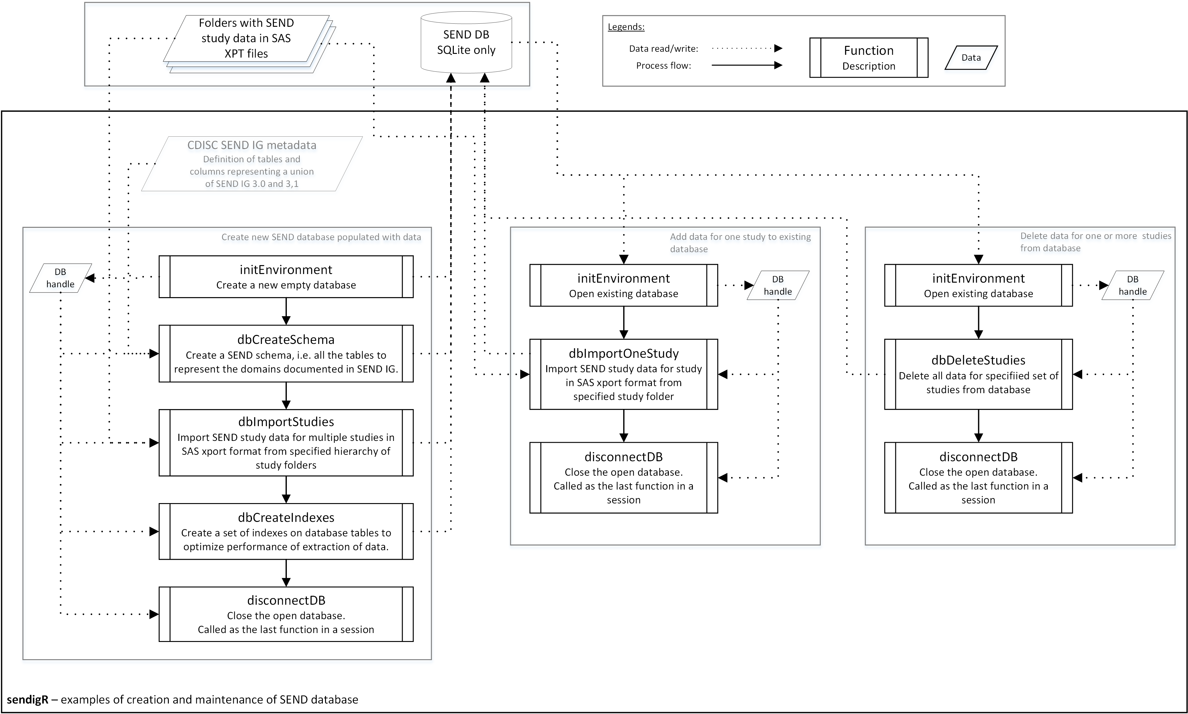
How to use sendigR to Build/Maintain a Database
Functions in the sendigR package can be used to generate a new SQLite database and add/remove studies from an existing SQLite or Oracle database.

Slide 10
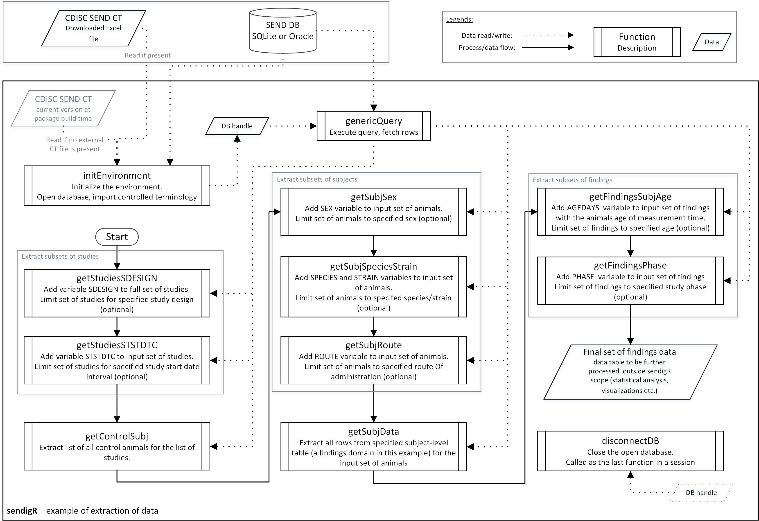
How to use sendigR to Query a Database
Functions in the sendigR package can be used to query a database of SEND data to extract findings from control animals that match specific criteria.

Slide 11
FDA Internal SEND Database
The sendigR R package has been used to build a database of all SEND datasets submitted to CDER.
This database is updated daily and is hosted on the OCS RAPID Platform where it can be utilized via:
R Shiny Web Applications
Custom Queries/Analyses using the R programming language
Potentially other IT applications

Slide 12
Applications of SEND Data to Support Regulatory Review
Software Solutions Provided by OCS
Janus Nonclinical
Interactively generate tabular summaries of toxicology study endpoints that can be filtered to export data tables describing key findings into review documents.
SEND Explorer
Interactively generates graphical summaries of toxicology study endpoints that can be used to explore toxicology study results.
Can visualize relationships between endpoints, e.g. Clin Path vs. Histopath.
Can visualize endpoint results across multiple studies within an application.

Slide 13
Applications of SEND Data to Support Regulatory Review
Software Solutions Developed by OND (leveraging the sendigR database)
Nonclinical Study Summary App
Concisely display exposure margins and key findings from several studies within the same drug application (presented at the Spring PT Townhall).

Slide 14
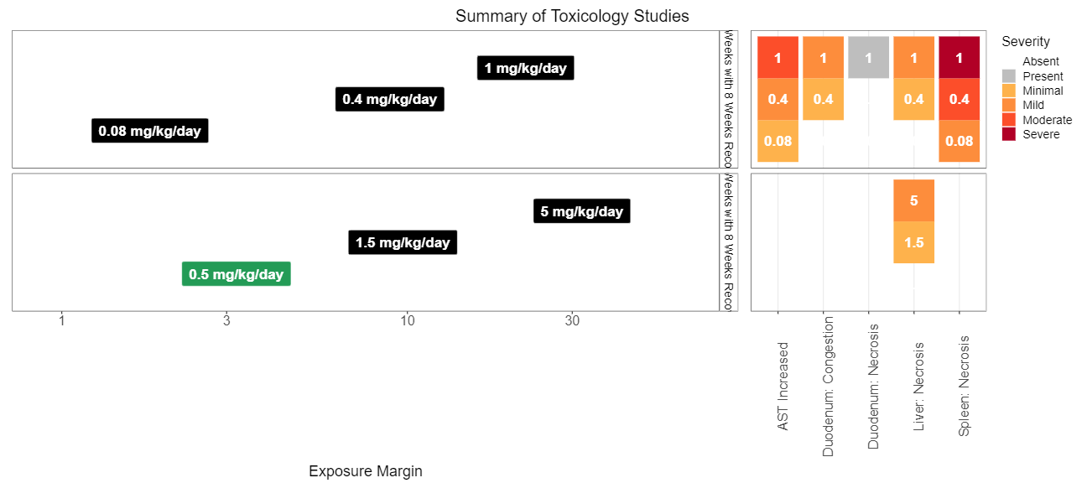
Nonclinical Study Summary App
Displays visualization summarizing study results:

Slide 15
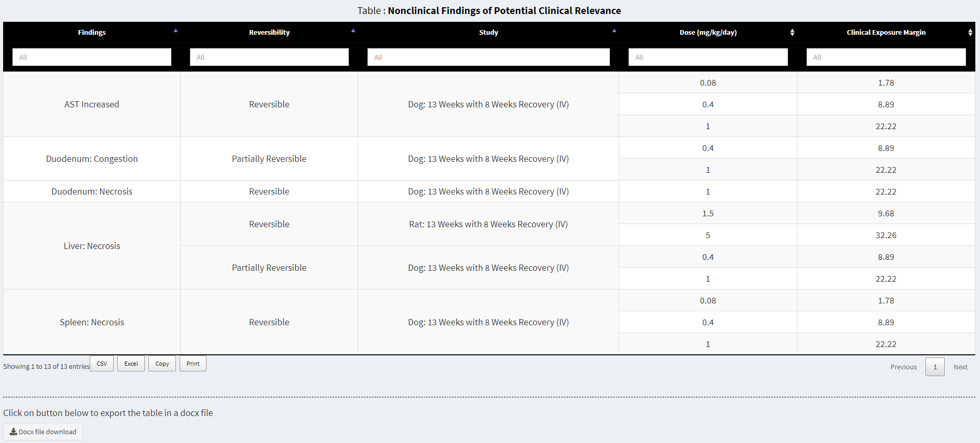
Nonclinical Study Summary App
Displays exportable tabular summaries of study results:

Slide 16
Applications of SEND Data to Support Regulatory Review
Software Solutions Developed by OND (leveraging the sendigR database)
Nonclinical Study Summary App
Concisely display exposure margins and key findings from several studies within the same drug application (presented at the Spring PT Townhall).
BioCelerate Cross Study Analysis App (under development)
Normalizes study endpoints for comparison across studies and calculates comparative scores of organ system toxicity based on relevant SEND endpoints.

Slide 17
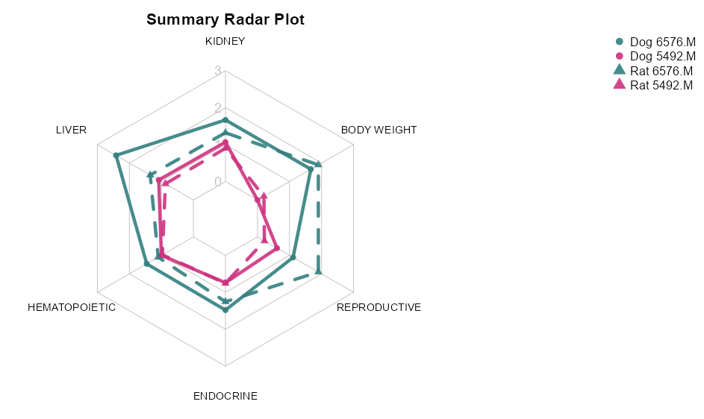
BioCelerate Cross-Study Analysis App
1 weak signal
2 moderate signal
3 strong signal

Slide 18
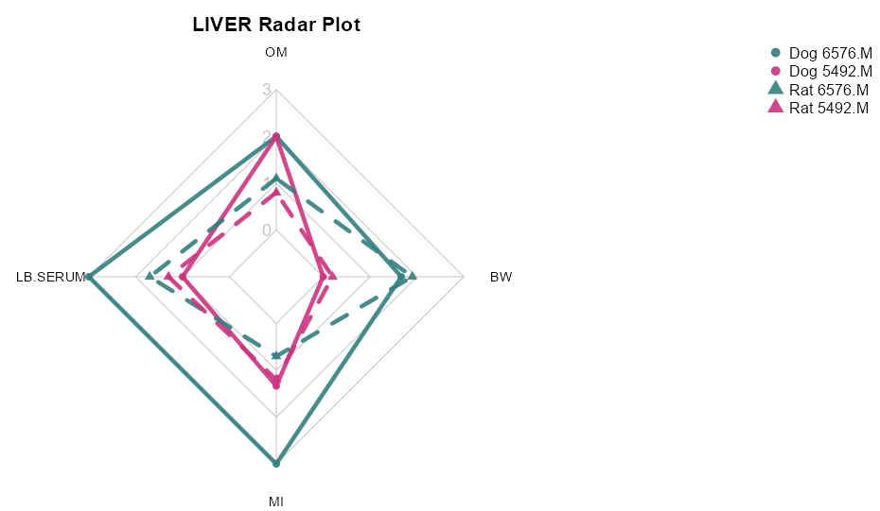
BioCelerate Cross-Study Analysis App

Slide 19
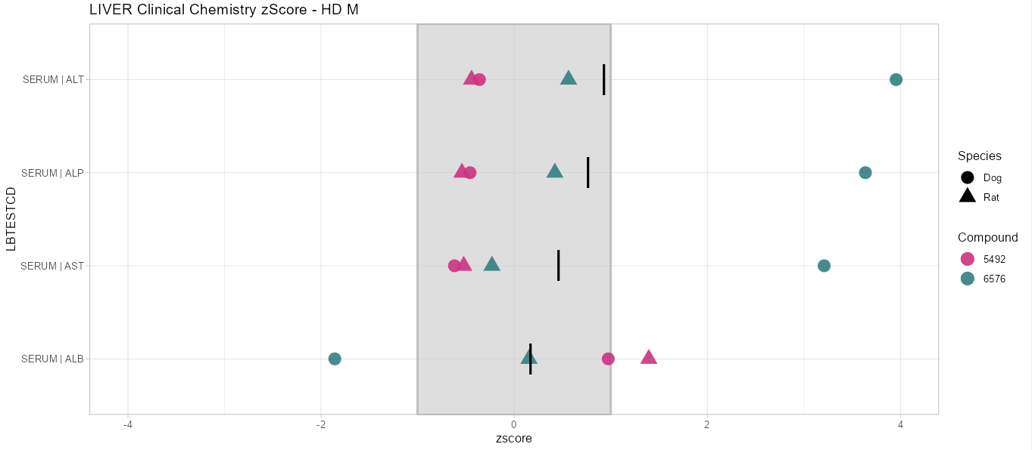
BioCelerate Cross-Study Analysis App

Slide 20
Applications of SEND Data to Support Regulatory Review
Software Solutions Developed by OND (leveraging the sendigR database)
Nonclinical Study Summary App
Concisely display exposure margins and key findings from several studies within the same drug application (presented at the Spring PT Townhall).
BioCelerate Cross Study Analysis App (under development)
Normalizes study endpoints for comparison across studies and calculates comparative scores of organ system toxicity based on relevant SEND endpoints.
Bayesian Toxicology App (under development)
Leverages historical control data and Bayesian inference to estimate the probability that increased incidence of a histopath finding is treatment-related.

Slide 21
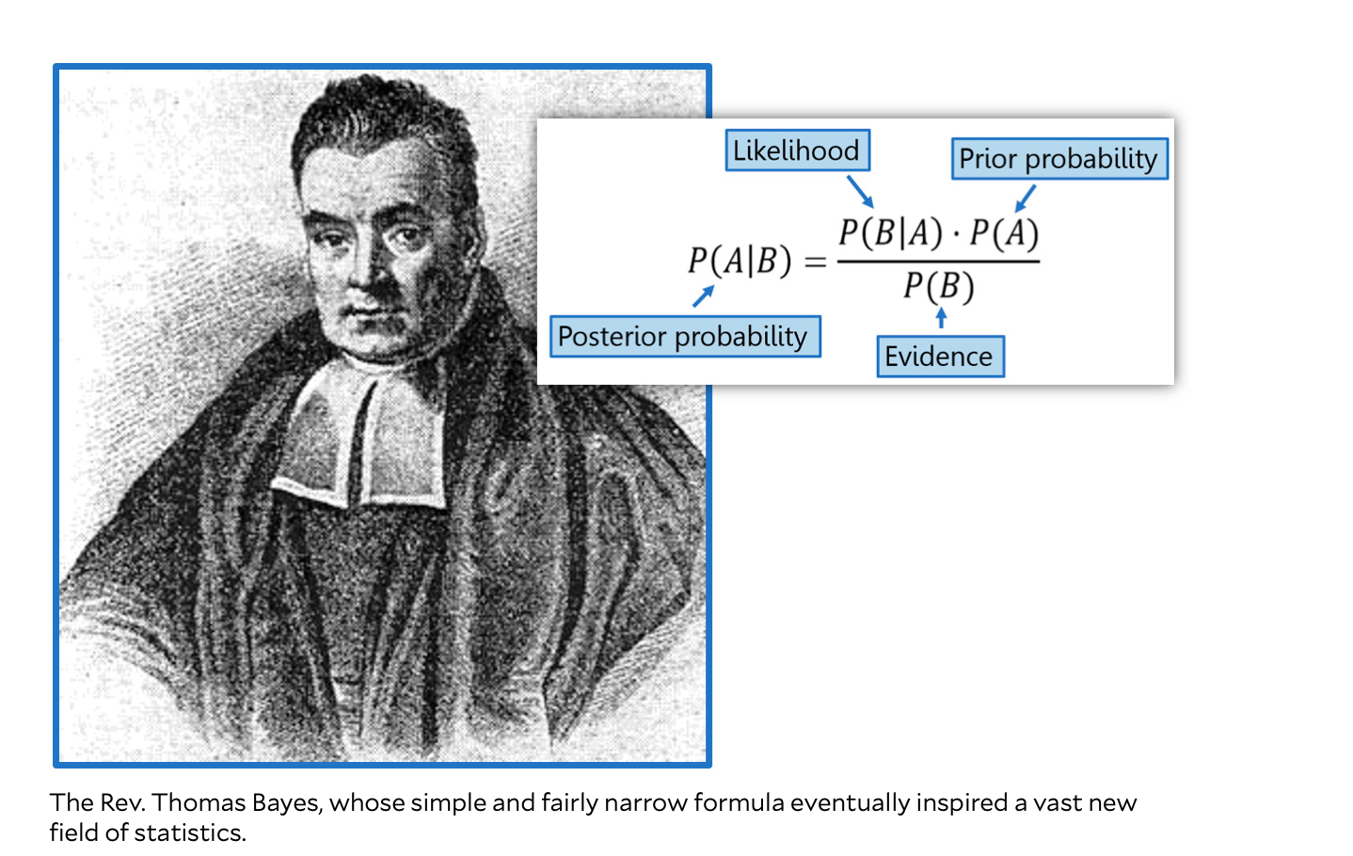
How to Integrate Historical Control Animal Information?
Notes:
Why choose Bayesian method?
For our toxicology study,
There are two possible outcomes, i.e. response or no response, when animal treated with placebo or treatment,
making this a good scenario for application of the beta binomial distribution.
Bayes theorem is illustrated in terms of probability as follows:
we are attempting to ascertain the conditional probability of A given B based on the conditional probability of B given A and the respective probabilities of A and B.
p(hypothesis | data)∝p(data | hypothesis)p(hypothesis)
posterior∝likelihood∗prior
See paper: use of historical control data for assessing treatment effects in clinical trials
Methods of borrowing: (fisher exact test done)
Separate- no borrowing
Pooling- use normal control, also we borrow historical control
Single arm trial- treatment group and only historical control
Test-then-pool– test whether control and historical control group similar, if yes then pool, if not then separate
Hierarchical modeling-
Nonclinical studies are done in small group, so we used Bayesian approach to incorporate historical control information.
https://www.motherjones.com/kevin-drum/2020/04/whats-the-deal-with-bayesian-statistics/

Slide 22
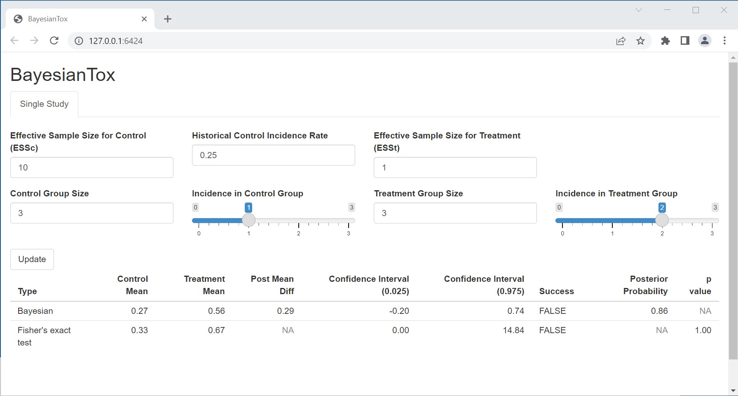
BayesianTox Shiny App

Slide 23
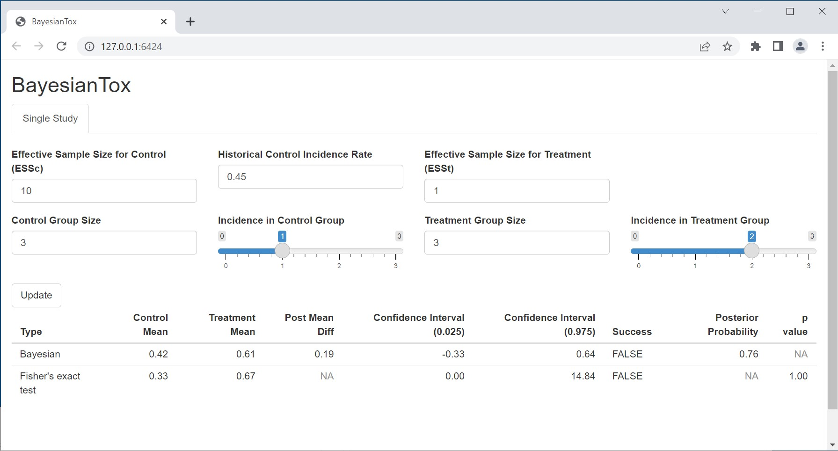
BayesianTox Shiny App

Slide 24

BayesianTox Shiny App

Slide 25
Applications of SEND Data to Support Knowledge Management
Nonclinical Study Summary App
Reviewers’ study interpretations, i.e. NOAEL, key findings, and safety margins based on clinical dosing will be stored for future reference.

Slide 26
Applications of SEND Data to Support Knowledge Management
Nonclinical Study Summary App
Reviewers’ study interpretations, i.e. NOAEL, key findings, and safety margins based on clinical dosing will be stored for future reference.
Predictive Modeling Projects
Proof-of-Concept: Modeling Relationship between Clinical Pathology Endpoints and Histopathological Signs of Hepatotoxicity

Slide 27
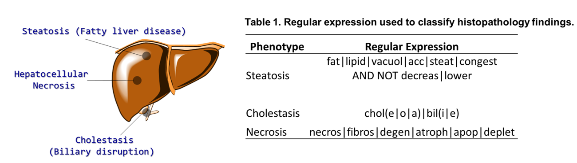
Modeling Relationship between Clinical Pathology Endpoints and Histopathological Signs of Hepatoxicity

Slide 28
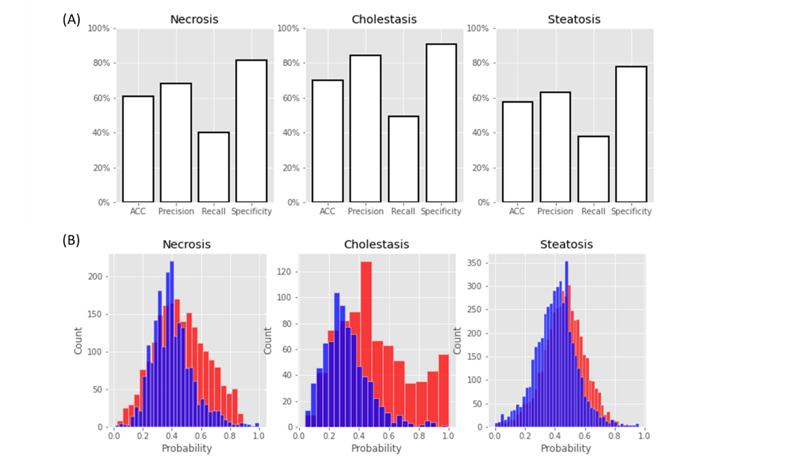
Predictive Model Performance
Predictive performance of models for each liver disease phenotypes.
Histogram of probability of phenotype for disease negative (blue) and disease positive (red) rats.

Slide 29
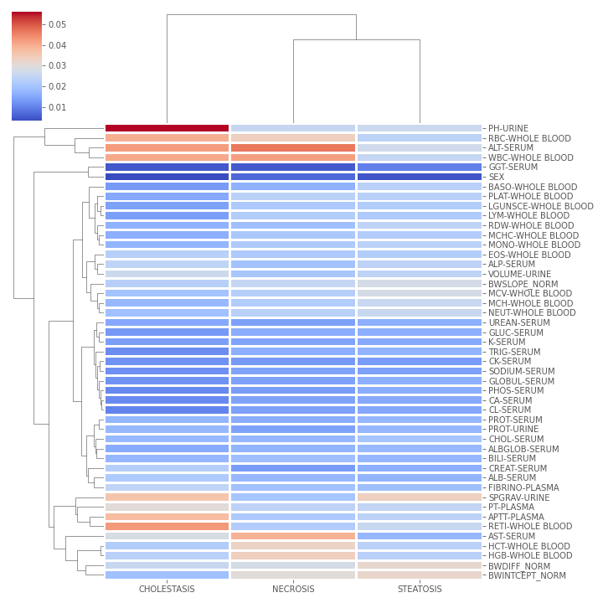
Gini Importance Score for Random Forest Models
In necrosis and cholestasis, protein levels alanine aminotransferase (ALT) contributed to the model along with tests that suggest anaemia i.e., red blood cells (RBC) and white blood cells (WBC).
The most contributory tests to the steatosis model consisted mostly of those describing changes in body weight (BWDIFF_NORM and BWINTERCEPT_NORM) likely due to the increase in liver size seen in fatty livers.
Additionally, as seen in the z-score profiles, the specific gravity of urine was also seen.).

Slide 30
Applications of SEND Data to Support Knowledge Management
Nonclinical Study Summary App
Reviewers’ study interpretations, i.e. NOAEL, key findings, and safety margins based on clinical dosing will be stored for future reference.
Predictive Modeling Projects
Proof-of-Concept: Modeling Relationship between Clinical Pathology Endpoints and Histopathological Signs of Hepatotoxicity
QSAR Modeling of Relationship between Chemical Features and Toxicological Profiles in SEND Data (ongoing project)

Slide 31
QSAR Modeling of Relationship between Chemical Features and Toxicological Profiles in SEND Data
Chemical structures have been downloaded from the GSRS database for drug applications with SEND-formatted toxicology study data.
Models are being developed to evaluate the relationship between chemical features and toxicology study results:
Normalized change in body weight is being evaluated as POC.
Organ system scores from the cross-study analysis app project will be evaluated next.
precisionFDA is going to host a challenge related to this topic that will allow researchers outside the agency to test their models against FDA SEND data.

Slide 32
Applications of SEND Data to Support Knowledge Management
Nonclinical Study Summary App
Reviewers’ study interpretations, i.e. NOAEL, key findings, and safety margins based on clinical dosing will be stored for future reference.
Predictive Modeling Projects
Proof-of-Concept: Modeling Relationship between Clinical Pathology Endpoints and Histopathological Signs of Hepatotoxicity
QSAR Modeling of Relationship between Chemical Features and Toxicological Profiles in SEND Data (ongoing project)
Modeling Relationships between SEND Toxicology Study Endpoints and Target Organs from PT Smart Template Reviews (future project)

Slide 33
Modeling Relationships between SEND Toxicology Study Endpoints and Target Organs from PT Smart Template Reviews
Target organs identified in repeat-dose toxicology studies are recorded by reviewers in the PT Smart Template Database.
Predictive models will be developed to evaluate whether toxicological profiles, i.e. patterns in SEND data, can be recognized by machine learning to predict which target organs will be identified by reviewers.
The impact of study design, e.g. species, sex, route of administration, etc., on these models can also be assessed.

Slide 34
Applications of SEND Data to Support Data-Driven Policy Development
Implementation of Virtual Controls Groups
The sendigR database will facilitate independent evaluations by OND of the impact of various stratification factors, i.e. route of administration, species/strain, age, etc., on the probability distribution of endpoints.
Simulation analyses can be run to determine how much variability in statistical identification of treatment effects would be produced by replacing/combining concurrent controls with virtual controls.

Slide 35
Applications of SEND Data to Support Data-Driven Policy Development
Implementation of Virtual Controls Groups
Q3E Extractables/Leachables Qualification
Development of QSAR models to predict general toxicology endpoints could enable an ICH M7-type approach to qualification of compounds detected in the extractables/leachables assessment of contain-closure systems for parenteral products.

Slide 36
Applications of SEND Data to Support Data-Driven Policy Development
Implementation of Virtual Controls Groups
Q3E Leachables/Extractables Qualification
Refinement of BSA-Based HED Start-Dose Selection Method
BSA-based HED-derived exposure margins can be compared against C_{max} and AUC-based exposure margins derived from large-scale analysis of TK data from SEND-formatted toxicology study data and SDTM-formatted clinical study data.
Other methods, e.g. PBPK modeling, could be explored as alternatives to BSA-based HED dose extrapoltation.

Slide 37
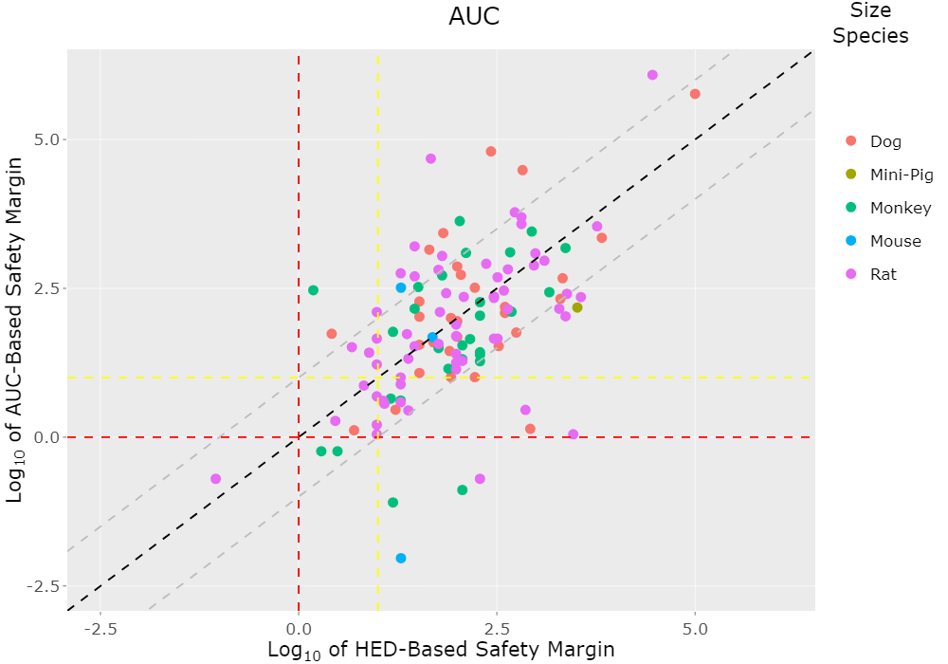
Correlation Between HED-Based and Exposure-Based Safety Margins at Starting Dose

Slide 38
Applications of SEND Data to Support Data-Driven Policy Development
Implementation of Virtual Controls Groups
Q3E Leachables/Extractables Qualification
Refinement of BSA-Based HED Start-Dose Selection Method
Secondary Pharmacology Binding Screen Guidance
Data-driven recommendations regarding which targets should be evaluated in secondary pharmacology binding screens could be developed based on large-scale analysis of the relationships between target binding and the occurrence of treatment-related findings in SEND-formatted toxicology studies.

Slide 39
Applications of SEND Data to Support Data-Driven Policy Development
Implementation of Virtual Controls Groups
Q3E Leachables/Extractables Qualification
Refinement of BSA-Based HED Start-Dose Selection Method
Secondary Pharmacology Binding Screen Guidance
Quantitative assessment of the added value of conducting chronic toxicology studies in rodent and nonrodent species
Evaluate which toxicities are more likely to be detected in:
Rodent vs. Nonrodent species
Chronic vs. Subchronic dosing durations

Slide 40
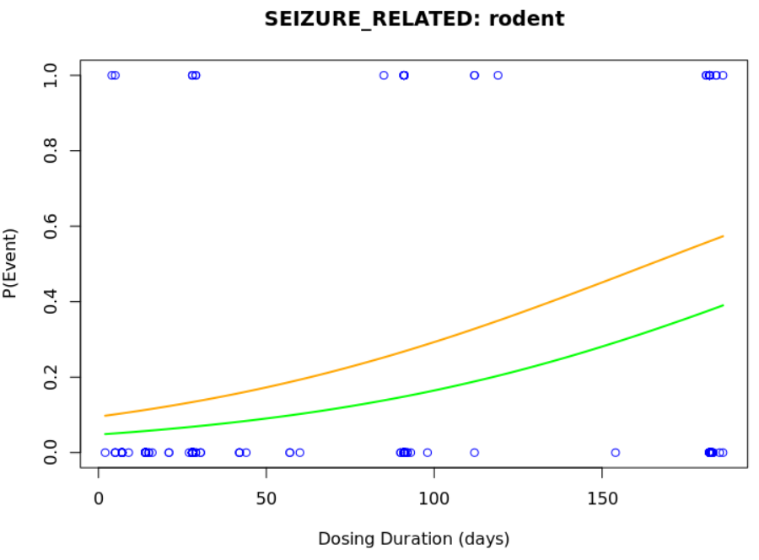
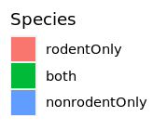
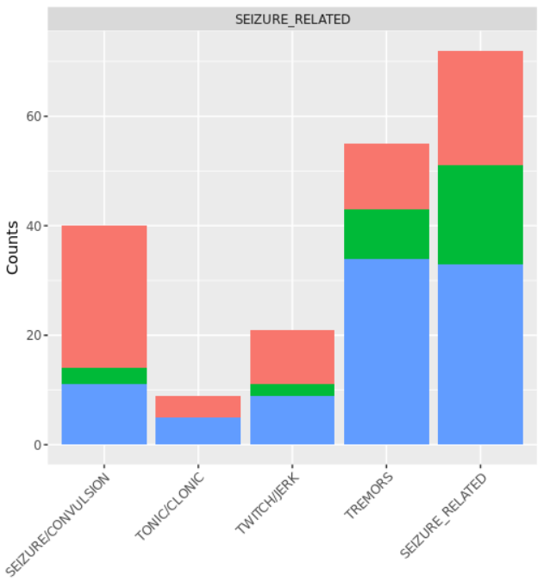
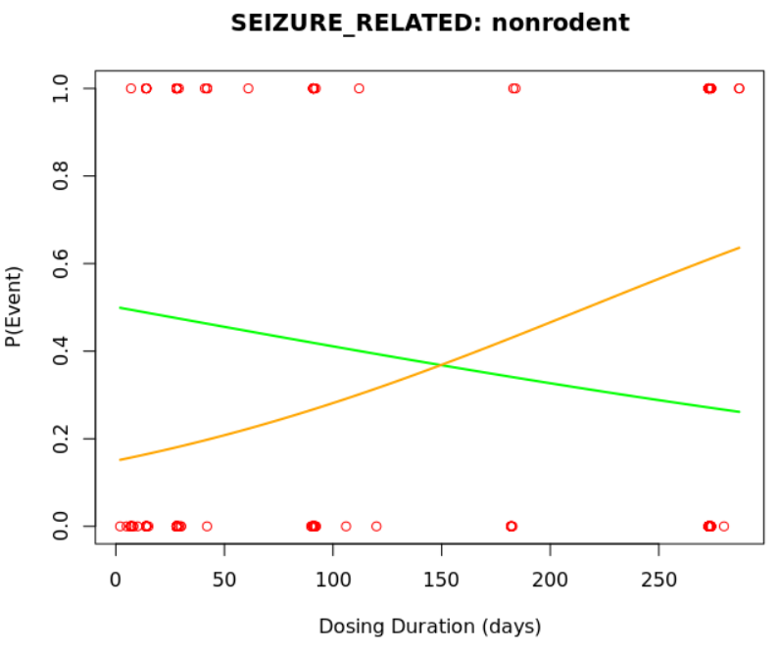
Quantitative assessment of the added value of conducting chronic toxicology studies in rodent and nonrodent species

Slide 41
Conclusion
The CDISC-SEND data standard has created new opportunities for collaborative development of open-source software solutions to facilitate cross-study analyses of toxicology study data.
FDA, BioCelerate, and PHUSE have collaboratively developed the sendigR R package, a free open-source software solution that will enable data scientists and toxicologists to interrogate large repositories of SEND-formatted toxicology study data.
The sendigR R package has been used to build a database containing all SEND datasets submitted to CDER that can be utilized by web applications and custom scripts to enhance regulatory review, knowledge management, and data-driven policy development.

Slide 42
Acknowledgments
FDA
Stephanie Leuenroth-Quinn
Md Yousuf Ali (ORISE)
Susan Butler (ORISE)
Girija Mallampalli (ORISE)
Sabbir Ahmed (ORISE)
Daniel Russo (ORISE)
BioCelerate
Mark Carfagna (Eli Lilly)
Brianna Paisley (Eli Lilly)
Bo Larsen (Novo Nordisk)
Bill Houser (BMS)
Wenxian Wang (BMS)

Slide 43
Questions

